Slide 1
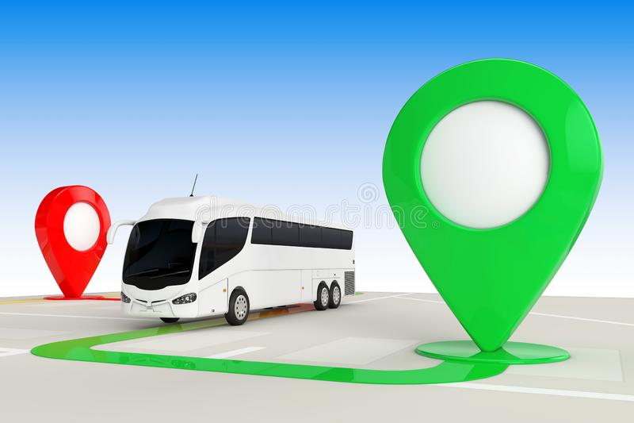
BUS TRACKING APPLICATION Guided By: Ms. B. Suvarna
Submitted By:
201FA04433
201FA04423
201FA04438
201FA04463

Slide 2
Contents
Introduction
Problem statement
Solution by our application
Development environment & SDK
Project module
Conclusion

Slide 3
Introduction
The bus tracking system uses GPS technology and software applications to track the location of buses and provide real-time updates to operators and Users.
These systems allow passengers to track buses in real-time.

Slide 4
Problem statement
Now a days students did not know the exact location of bus.
so that sometimes they missed the buses to transport.
Students also miss the transport due to the lack information about the bus arriving and departure time.

Slide 5
Solution by our application
VBT android app will give the solution of all problem. About location of buses.
Students or users will easily able to track the location of buses using this android system in their phone.
Driver will share the location by route.
Using the route users can find the bus location.

Slide 6
Development environment & SDK
For developing this project we used the Android studio of version android 13.

Slide 7
Project module
This project module are divided into three module as:
Module 1: Driver information & Location.
There will be a dialog detail about drivers name, phone , email, licence number.
Module2:Map
Map to show the current location of buses and users.
Module3:Bus Route Information
Choosing the route they can find the available buses through that route.

Slide 8
Conclusion
The conclusions of this study suggest that knowledge of specific domain improves the results.
This Project has been implemented on Android platform. Also, different attributes have been added to the project which will prove to be advantageous to the system.

